Slide 1
Regression Part II
Justin M. Rao, MSR-NYC

Slide 2
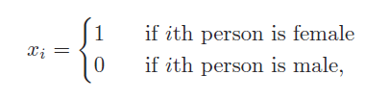
Feature types
Binary features: equal to 1 or 0. For example:
Continuous features: can take an real value
Categorical features: can take one of N values. E.g. Saturday, Sunday, Monday… declaring as.factor then R will treat it as N binary variables for each category (ex. =1 if Saturday, =0 otherwise)

Slide 3
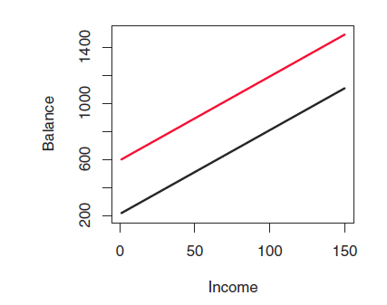

Understand binary features
$β_{1}$ allows for a different y-intercept for students
$$y_{i}=α+β_{1}\{1 if student\}+β_{2}income+ε_{i}$$

Slide 4
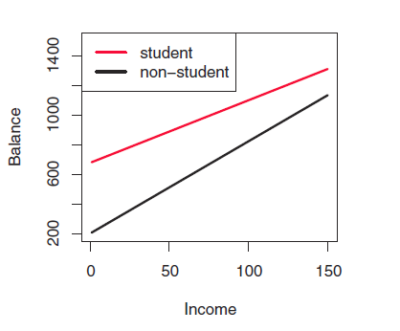

Understand binary features
$β_{1}$ allows for a different
y-intercept for students
$β_{3}$ allows for a different
Slope for students
$$y_{i}=α+β_{1}\left\{1 if student\right\}+β_{2}income+β_{3}\left\{1 if student\right\}∗income+ε_{i}$$

Slide 5
Interaction terms
Interaction term: multiplying two features by each other. When done as such:
{continuous feature}*{binary feature}
it allows for a different slope for the group represented by the binary feature. Note, be sure to include the continuous feature without the interaction as well.
Example, suppose temperature has a different impact on # of bikeshare trips taken on weekdays vs. weekends. We can create a binary variable is_weekend.
If we add is_weekend to the model, we allow for a different baseline ridership on weekends. If we add is_weekend*temp, we allow temperature to have a different effect for weekends.
We can “interact” is_weekend with a polynomial in temp. This effectively gives us a new model for temperature for the weekends vs. weekdays

Slide 6
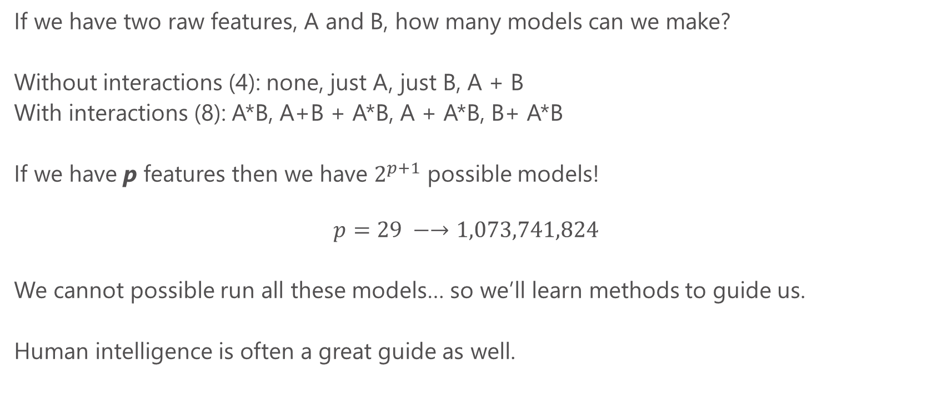
Feature explosion
If we have two raw features, A and B, how many models can we make?
Without interactions (4): none, just A, just B, A + B
With interactions (8): A*B, A+B + A*B, A + A*B, B+ A*B
If we have p features then we have $2^{p+1}$ possible models!
$$p=29 −→1,073,741,824$$
We cannot possible run all these models… so we’ll learn methods to guide us.
Human intelligence is often a great guide as well.

Slide 7
Interpreting regression output
Summary(my_model) gives the coefficient estimates (beta’s), t-statistics, standard errors and p-values.
t-statistics evaluate the hypothesis that the coefficient is equal to zero. Thus t greater than 1.96 in absolute value allows us to reject this hypothesis at the 95% level. P-values simply convert t-stats into the probability we would get something this far from zero due to sampling chance alone.
Note that t-statistics evaluate features “one by one”. Overall model fit is a better guide for explanatory power (e.g. we might be better for leaving insignificant features in sometimes)
t-stats can be a good guide to throw out irrelevant features

Slide 8
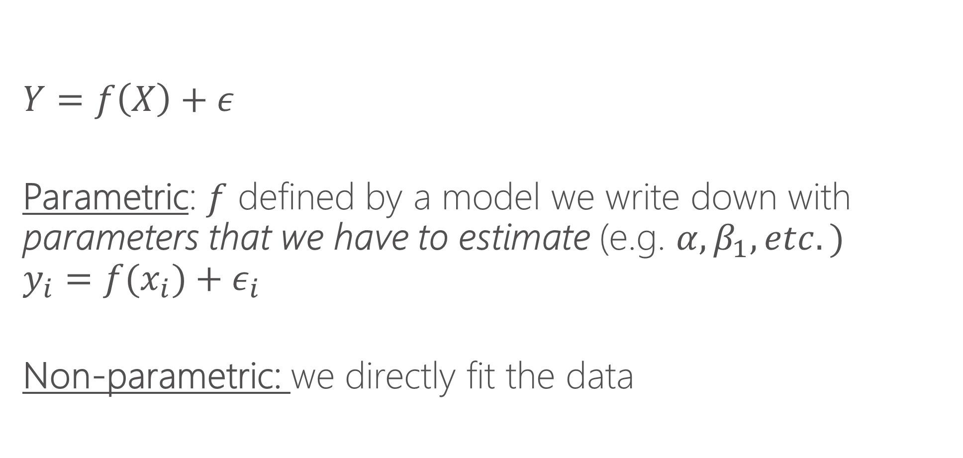
Parametric vs. non-parametric regresion
$$Y=f\left(X\right)+ε$$
Parametric: $f$ defined by a model we write down with parameters that we have to estimate (e.g. $α, β_{1}, etc.)$
$$y_{i}=f(x_{i})+ε_{i}$$
Non-parametric: we directly fit the data

Slide 9
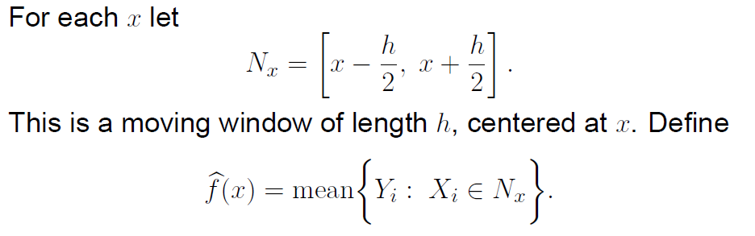
Local averaging

Slide 10
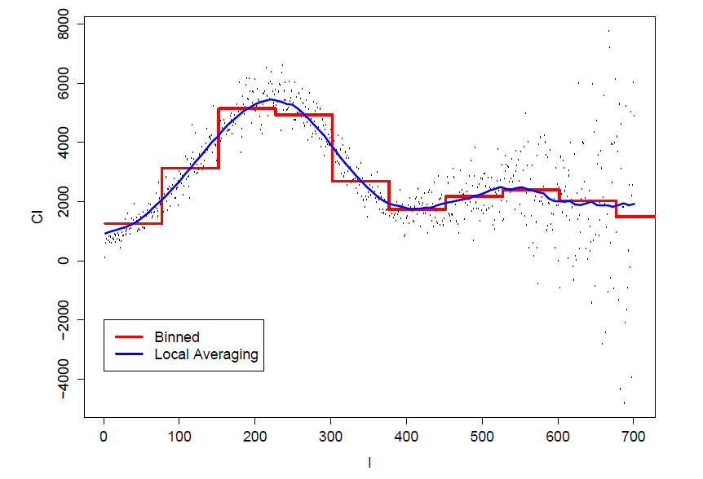
Local averaging vs. bins

Slide 11
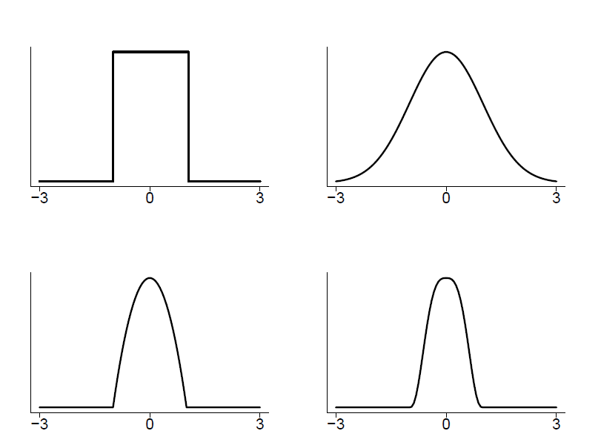
Kernels
A method of assigning higher weight to the points closer to the target point I am trying to fit

Slide 12
Bandwidths
Bandwidths tell us how wide to make our kernel (window)
Larger bandwidths → smoother functions because there is more data used to make the averages
Bandwidth is sometimes called the smoothing parameter

Slide 13
K-nearest neighbors
An alternative to bandwidths is instead of specifying a fixed window, we can say “use the nearest K nearest neighbors”
This ensures each bin has the same amount of data and can be a useful tool
Functionally it will often be quite similar to using a bandwidth, except when there are “sparse data” issues (then K-NNN is preferred)
Often expressed as a fraction of data. E.g. NN=.1 says “each bin is 10% of data”

Slide 14
Local polynomial regression
Thing of local averaging as fitting a constant for a given window of data
Instead of fitting a constant, we can fit a line (y=a*x + b) or a polynomial (y=a*x + b*x^2 + c), etc.
It is thus more general than local averaging, but very similar

Slide 15
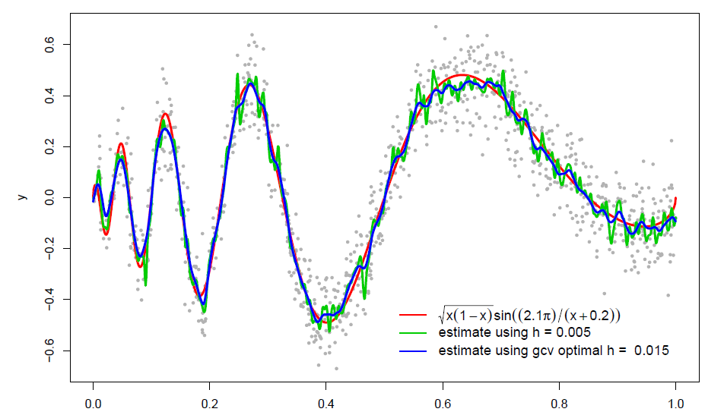
Some examples

Slide 16
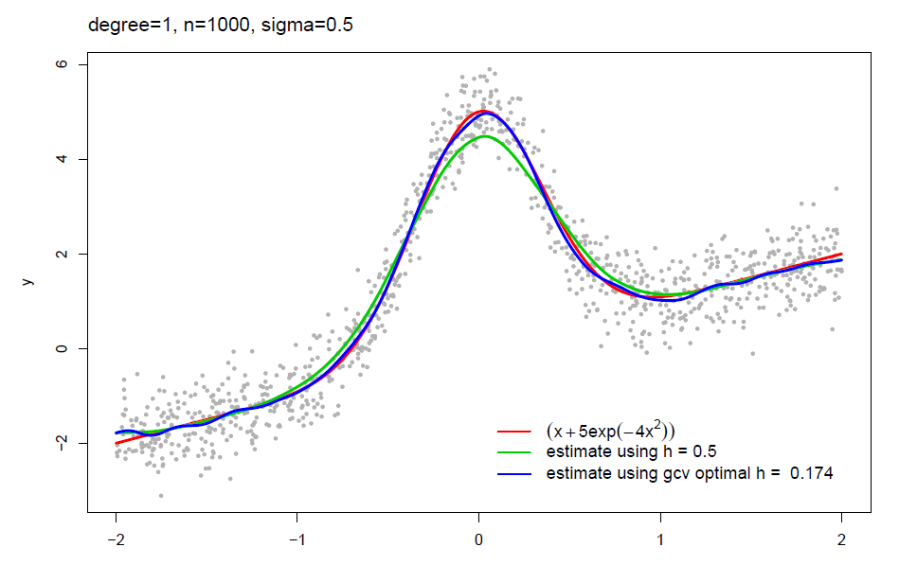
Some examples

Slide 17
Local polynomial in R locfit install.packages(locfit) library(locfit) Modeler needs to specify: bandwidth (or fraction of nearest neighbors), degree of the local polynomial Contrast: in parametric regression, we had to write down a model Aside: we’ll learn that non-parametric methods struggle in higher dimensions

